Slide 1
Deposit Management

Slide 2
Introduction
Deposits are a key element in defining what a banking firm really does and what critical roles it really plays in the economy
Moreover, deposits provide much of the raw material for making loans and, thus, may represent the ultimate source of profits and growth for a depository institution
Two key issues every depository institution must deal with in managing the public’s deposits
Where can funds be raised at lowest possible cost?
How can management ensure that the institution always has enough deposits to support lending and other services the public demands?

Slide 3
Types of Deposit Accounts
11-3
Demand Deposits
Funds deposited can be withdrawn by the depositor at any time without any advanced notice to banks. The ownership of demand deposits can be transferred from one person to another via cheques or electronic transfers. There is no fixed term to maturity.
Two Types of demand deposits
Savings Accounts
Current Accounts

Slide 4
Types of Deposit Accounts …
Savings Accounts
Accrue interest at a fixed rate set by the commercial banks.
restrictions on the number of withdrawals as well as on the amounts of withdrawals during any specified period.
Minimum balances may be prescribed in order to offset the cost of maintaining and servicing such deposits
Current Accounts
The bank is obliged to pay the money on demand.
The Current accounts don’t bear any interest
Cost to maintain the accounts is high and banks ask the customers to keep a minimum balance

Slide 5
Types of Deposit Accounts …
Term Deposits
Deposits with fixed tenure
Interest rate depends upon the tenure and amount of deposit.
This rate varies from bank to bank.
The interest rate is generally higher for time deposits of longer tenure
Three types of term deposits
Fixed deposits
Re-investment deposits
Recurring deposits

Slide 6
Types of Deposit Accounts …
Fixed deposit
A fixed rate of interest is paid at fixed, regular intervals
Re-investment deposit
Interest is compounded quarterly and paid on maturity, along with the principal amount of the deposit. In the Flexi Deposits amount in savings deposit accounts beyond a fixed limit is automatically converted into term-deposits.
Recurring deposit
Fixed amount is deposited at regular intervals for a fixed term and the repayment of principal and accumulated interest is made at the end of the term

Slide 7
Types of Deposit Accounts …
Non Resident Ordinary Accounts: (NRO): Any person resident outside of India can open this account. When a resident becomes a non resident, his domestic rupee account gets converted into the NRO account. This helps the NRI to get his credits which accrue in India.
Non-Resident (External) Rupee Account: It’s a Rupee account and the NRI can remit money to India from the funds abroad.
Foreign Currency Non-Resident Account: (FCNR): This account is opened by the NRIs in 6 designated currencies as follows: US Dollar (USD) Great Britain Pound (GBP) Euro (EUR) Japanese Yen (JPY) Canadian dollar (CAD) and Australian dollar (AUD)

Slide 8
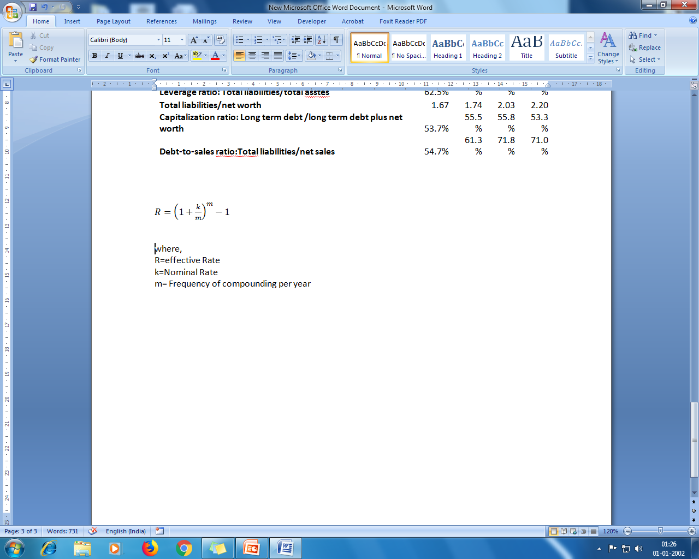
Nominal versus Effective Rate
Apart from the annual compounding, if the interest is compounded ,monthly/quarterly/half-yearly, the effective rate of interest for such periods will be different from the nominal rate
where,
R=effective Rate
k=Nominal Rate
m= Frequency of compounding per year

Slide 9
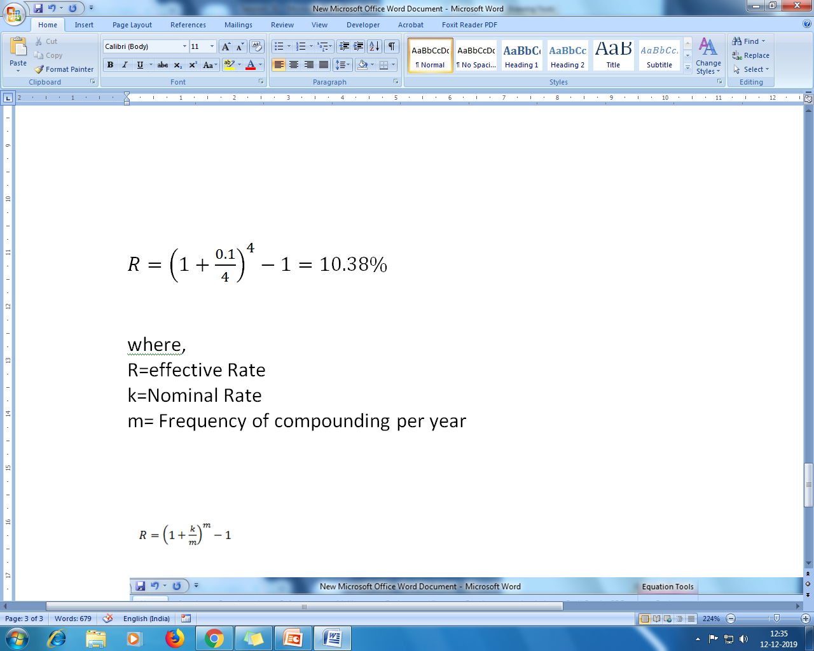
Nominal versus Effective Rate: Example
If the nominal rate of interest on a 2 year term deposit is 10 percent and if the interest amount is compounded on a quarterly basis then the effective rate can be assessed as:

Slide 10
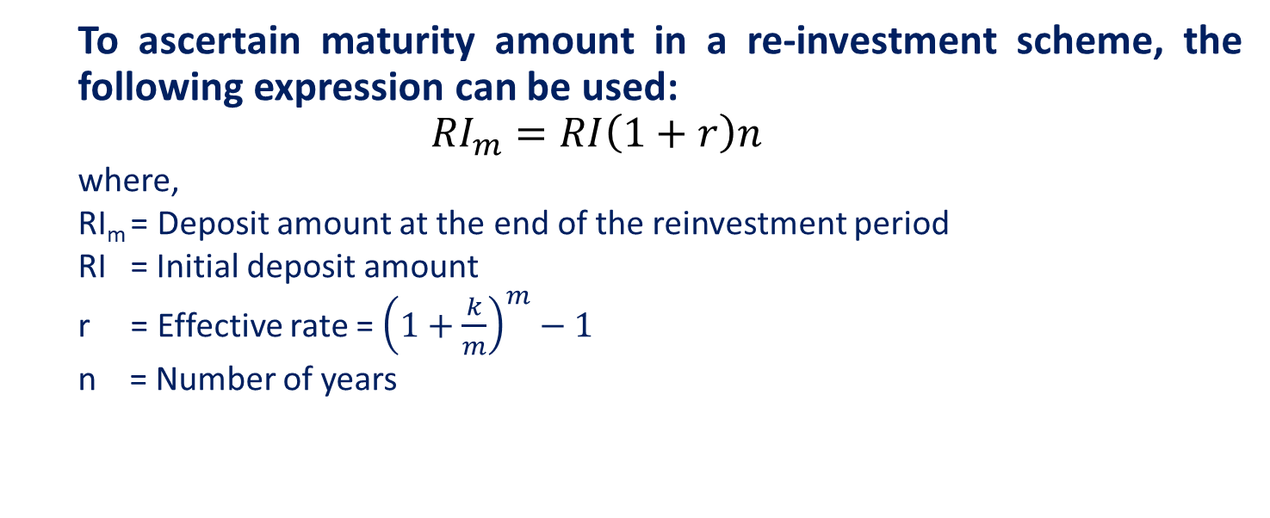
Reinvestment Scheme
To ascertain maturity amount in a re-investment scheme, the following expression can be used:
$${RI}_{m}=RI\left(1+r\right)n$$
where,
RI_{m} = Deposit amount at the end of the reinvestment period
RI = Initial deposit amount
r = Effective rate = ${\left(1+\frac{k}{m}\right)}^{m}−1$
n = Number of years

Slide 11
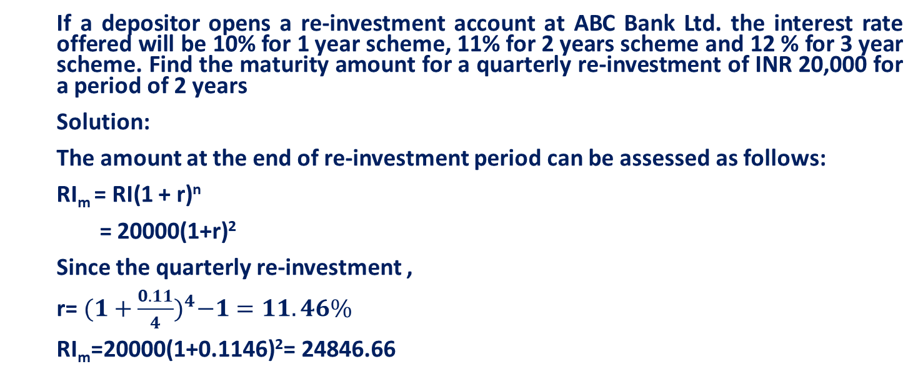
Reinvestment Scheme: Example
If a depositor opens a re-investment account at ABC Bank Ltd. the interest rate offered will be 10% for 1 year scheme, 11% for 2 years scheme and 12 % for 3 year scheme. Find the maturity amount for a quarterly re-investment of INR 20,000 for a period of 2 years
Solution:
The amount at the end of re-investment period can be assessed as follows:
RI_{m} = RI(1 + r)^{n}
= 20000(1+r)²
Since the quarterly re-investment ,
r= ${(1+\frac{0.11}{4})}^{4}−1=11.46\%$
RI_{m}=20000(1+0.1146)²= 24846.66

Slide 12
Cash Certificate
Issue Price= PV = Face Value(PIVFA_{n,k})
where,
N = Tenor
K = Interest rate

Slide 13
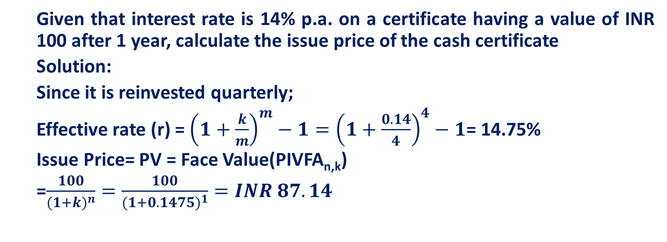
Cash Certificate
Given that interest rate is 14% p.a. on a certificate having a value of INR 100 after 1 year, calculate the issue price of the cash certificate
Solution:
Since it is reinvested quarterly;
Effective rate (r) = ${\left(1+\frac{k}{m}\right)}^{m}−1={\left(1+\frac{0.14}{4}\right)}^{4}−1$= 14.75%
Issue Price= PV = Face Value(PIVFA_{n,k})
=$\frac{100}{{(1+k)}^{n}}=\frac{100}{{(1+0.1475)}^{1}}=INR 87.14$

Slide 14
Recurring Deposit Scheme
To arrive at the amount on maturity, the future value of annuity is be calculated as:
RD_{m}=RD(FVIFA_{n,k})
where,
RD_{m} = Maturity value of deposit
RD = Installment amount

Slide 15
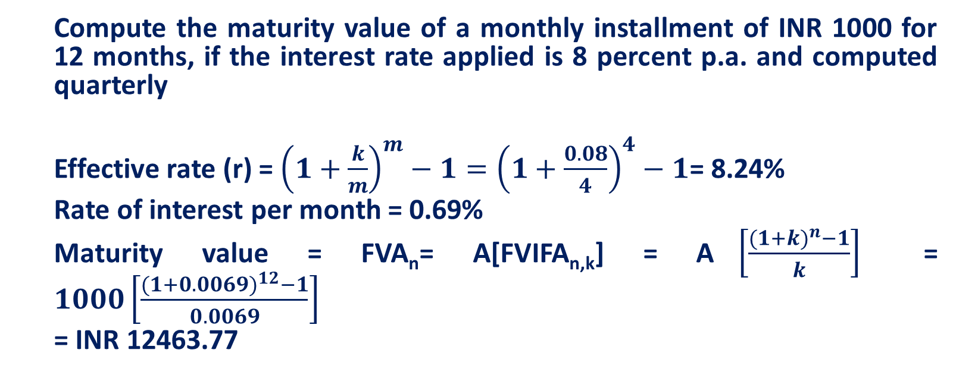
Recurring Deposit Scheme
Compute the maturity value of a monthly installment of INR 1000 for 12 months, if the interest rate applied is 8 percent p.a. and computed quarterly
Effective rate (r) = ${\left(1+\frac{k}{m}\right)}^{m}−1={\left(1+\frac{0.08}{4}\right)}^{4}−1$= 8.24%
Rate of interest per month = 0.69%
Maturity value = FVA_{n}= A[FVIFA_{n,k}] = A$\left[\frac{({1+k)}^{n}−1}{k}\right]$ = $1000\left[\frac{({1+0.0069)}^{12}−1}{0.0069}\right]$
= INR 12463.77

Slide 16
Pricing of Deposits
Management needs to pay a high enough interest rate to customers to attract
But must avoid paying interest rate so costly that it erodes the potential profit margin from using customer funds

Slide 17
Pricing Deposits
Development of interest bearing chequable deposits offered financial managers the opportunity to consider the pricing of deposit services : below cost pricing
Customer charges were set below the true level of operating and overhead costs associated with providing deposit services
Substantially increased rate of return to customer known as implicit interest rate – the difference between the true cost of supplying fund-raising services and the service change actually assessed to customer

Slide 18
Pricing Deposits at Cost Plus Profit Margin
Deregulation increased competition, and raised the average real cost of a deposit for deposit service providers
More frequent use of unbundled service pricing
Deposits were priced separate from other services
Each deposit service is often priced high enough to recover all or most of cost of providing that service using the cost-plus pricing method:
Unit price charged the customer for each deposit service | = | Operating expense per unit of deposit service | + | Estimated overhead expense allocated to deposit service function | + | Planned profit margin from each service unit sold

Slide 19
Pricing Deposits at Cost Plus Profit Margin
Estimating deposit services cost:
Tying deposit prices to cost of deposit –service production has encouraged service providers to match prices and costs more closely and eliminate many formerly free services
Cost plus pricing demands an accurate calculation of the cost of each deposit service
This requires management to
Calculate the cost rate of each source of funds (adjusted for reserves required by the central bank, deposit insurance fees, and float)
Multiplying each cost rate by the relative proportion of all funds coming from the popular sources
Sum of all resulting products to drive the weighted average cost of all funds raised
This pooled-funds cost approach is based on assumption that it is not the cost of each type of deposits that matter, rather the weighted average cost of all funding sources for each depository institution

Slide 20
Pricing Deposits at Cost Plus Profit Margin: Example
Problem:
Suppose a depository institution has raised a total of $800 million
Amount as checkable deposits $200 million
Amount in saving and time deposit $400 million
Amount borrowed from money market $100 million
Amount from owners in form of equity capital $100 million
Equity capital costs an estimated 22% of any new capital raised
Interest and non interest costs spent to attract :
Checkable deposit: 10% of checkable deposit
Thrift deposit: 11% of thrift deposit
Money market borrowing: 11% of money market borrowing
Reserve requirements, deposit insurance fees and uncollected balances reduce amount of money by:
15% for checkable deposits
5% for thrift deposits
2% for borrowing in the money market

Slide 21
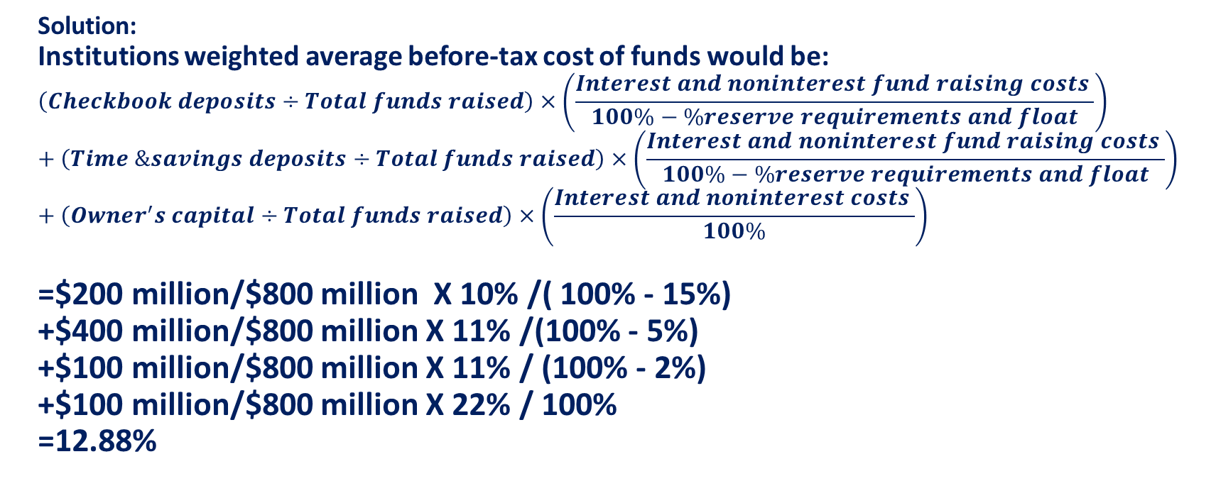
Pricing Deposits at Cost Plus Profit Margin: Example
Solution:
Institutions weighted average before-tax cost of funds would be:
$$\left(Checkbook deposits÷Total funds raised\right)×\left(\frac{Interest and noninterest fund raising costs }{100\%−\%reserve requirements and float}\right)+\left(Time \&savings deposits÷Total funds raised\right)×\left(\frac{Interest and noninterest fund raising costs }{100\%−\%reserve requirements and float}\right)+\left(Owner^{′}s capital÷Total funds raised\right)×\left(\frac{Interest and noninterest costs }{100\%}\right)$$
=$200 million/$800 million X 10% /( 100% - 15%)
+$400 million/$800 million X 11% /(100% - 5%)
+$100 million/$800 million X 11% / (100% - 2%)
+$100 million/$800 million X 22% / 100%
=12.88%

Slide 22
Using Marginal Cost to Set Interest Rates on Deposits
Marginal Cost Approach:
Marginal cost: added cost of bringing new funds
Marginal and not historical average cost should be used to to help price funds
Frequent changes in interest rate makes historical average costs a treacherous standard for pricing
If interest rates are declining, marginal cost of raising new funds may fall below historical average cost over all funds used
If interest rates increase, marginal cost of today’s new money may substantially exceed the historical cost

Slide 23
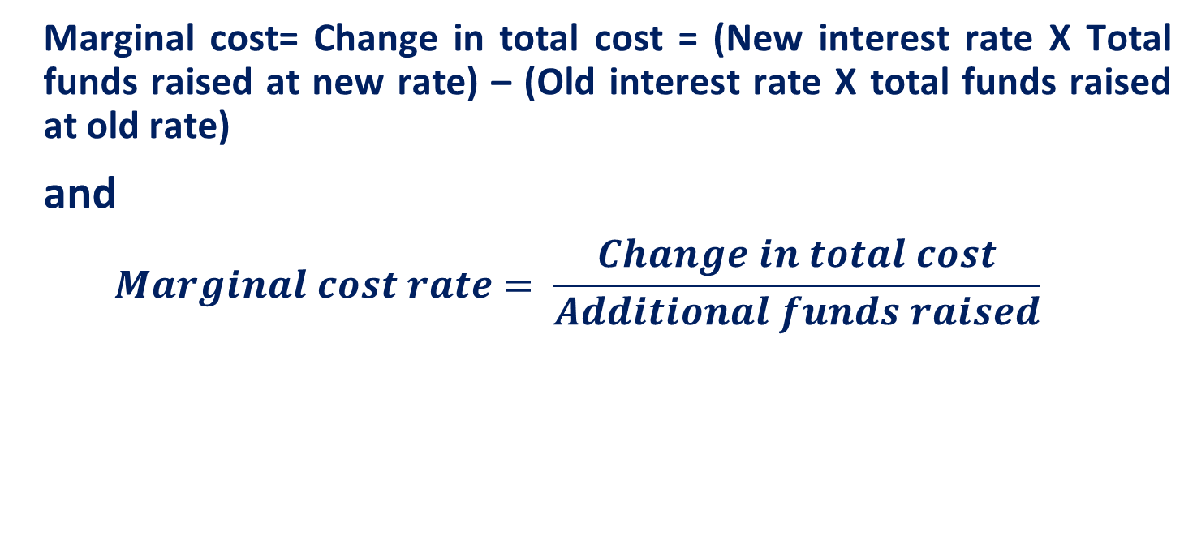
Using Marginal Cost to Set Interest Rates on Deposits
Marginal cost= Change in total cost = (New interest rate X Total funds raised at new rate) – (Old interest rate X total funds raised at old rate)
and
$$Marginal cost rate= \frac{Change in total cost}{Additional funds raised}$$

Slide 24
Marginal cost approach Example
Expected amounts of deposits that will flow in | Average interest the bank will pay on new funds | Total interest cost of new funds ($) | Marginal cost of new deposit money ($) | Marginal cost as a percentage of new funds attracted (%) | Expected marginal revenue (return) from investing the new funds | Difference between marginal revenue and marginal cost rate | Total profits earned (after interest cost) ($)
30 | 7% | 2.10 | 2.1 | 8.4% | 10% | 2% | 0.900
60 | 7.50% | 4.50 | 2.4 | 9.6% | 10% | 0% | 1.500
90 | 8% | 7.20 | 2.7 | 10.8% | 10% | -1% | 1.800
120 | 8.50% | 10.20 | 3 | 12.0% | 10% | -2% | 1.800
150 | 9% | 13.50 | 3.3 | 13.2% | 10% | -3% | 1.500

Slide 25
Using Marginal Cost to Set Interest Rates on Deposits
Marginal cost approach provides information on
Setting deposit interest rate
Deciding how far institution should go in expanding its deposit base before the added cost of deposit growth catches up with additional revenues and total profits begin to decline
When profits start to fall: either find new sources of funding with lower marginal costs or identify new assets promising greater marginal revenue, or both

Slide 26
Using Marginal Cost to Set Interest Rates on Deposits
Conditional Pricing
Depository sets up a schedule of fees in which customer pays a low fee or no fee if the deposit balance remains above some minimum level, but faces a higher fee if average balance falls below minimum
Customer pays a price conditional on how they use deposit
Deposit prices vary based on one or more of these factors:
Number of transactions passing through account
Average balance held in the account over a designated period
Maturity of deposits in days, weeks or month

Slide 27
Using Marginal Cost to Set Interest Rates on Deposits
Conditional Pricing
Economist Constance Dunham classified checking account conditional pricing schedule into three broad category: (1)flat-rate pricing, (2)free pricing and (3) conditionally free pricing
Flat-rate pricing: depositor’s cost is a fixed charge per check, per time or both
Free pricing: absence of a monthly account maintenance fee or per-transaction charge
Conditionally free pricing: favors large denomination deposits because services are free if account balance stays above some minimal figure

Slide 28
Pricing Based on the Total Customer Relationship and Choosing a Depository
Targeting the best customers for special treatment according to the number of services the customer uses
Customers who choose two or more services may be granted lower deposit fees
Idea: selling multiple services to customers increases the customer’s dependence; makes it harder to go elsewhere
Relationship pricing promoted greater customer loyalty and less sensitive to prices offered by competitive firms

Slide 29
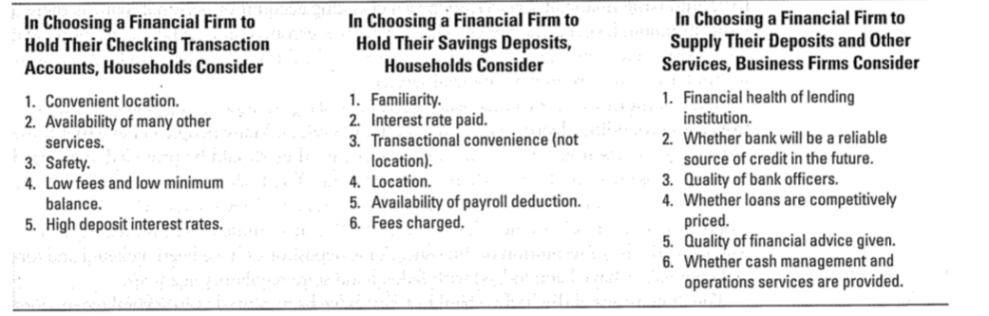
Pricing Based on the Total Customer Relationship and Choosing a Depository
Factors customers and businesses consider when choosing institution:

